Slide 1
Earley Parsing
Aidan Schaubhut and Joel Porter

Slide 2



Introduction to Parsing Algorithms
The Role of Parsing in Natural Language Processing
Parsing in NLP
Parsing algorithms analyze the syntactic structure of sentences, crucial for understanding and processing natural language.
Importance of Efficiency
Efficient parsing is essential for real-time applications and large-scale data processing.
Focus on Earley's Algorithm
One of the foundational algorithms for context-free grammar parsing, known for its flexibility and applicability.
Notes:
Parsing algorithms are fundamental in natural language processing (NLP) as they help computers understand the syntactic structure of sentences. This process is essential for applications like machine translation, speech recognition, and more. Efficiency in parsing algorithms is critical, especially for real-time applications that require immediate responses. Earley's algorithm, introduced in 1970, remains one of the most significant contributions to the field, offering a robust method for parsing all context-free grammars. Today, we will explore its mechanics and how recent innovations have enhanced its performance.

Slide 3
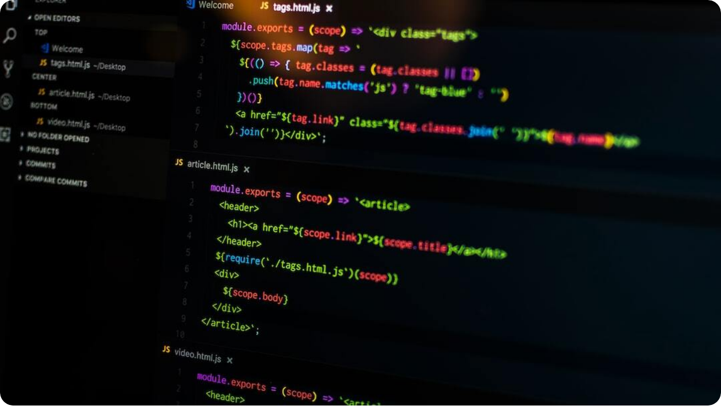
Overview of the Earley Parsing Algorithm
Core Concepts and Functionality
Incremental Parsing: Processes input sequentially from left to right, enabling real-time parsing applications.
Efficiency in Parsing: Originally designed with O(N^3) complexity, suitable for unambiguous and certain bounded grammars.
Top-Down & Bottom-Up Combination: Earley's method blends goal-driven and data-driven techniques, optimizing parsing routes.
Photo by Pankaj Patel on Unsplash
Notes:
The Earley Parsing algorithm, created by Jay Earley in 1970, is an incremental parser that processes input from left to right. This approach makes it versatile for applications that require parsing while the input is still being received, such as interactive or real-time language processing. Earley's algorithm was also one of the first to handle context-free grammars with a time complexity of O(N^3) in the general case, achieving faster speeds for specific unambiguous or bounded grammars. It uniquely combines top-down and bottom-up strategies, where top-down parsing sets goals based on expected structures and bottom-up parsing verifies these structures against the actual input data, creating a highly adaptable parsing system.

Slide 4

Semiring-Weighted Parsing Innovations
Incorporating Weights into Parsing
Weighted Context-Free Grammar: Extends CFG by assigning weights to productions, allowing for probabilistic parsing.
Efficiency and Scalability: Reduces runtime by factoring in production weights, enabling faster processing of large grammars.
Applications in NLP: Improved parsing for tasks such as speech recognition and language modeling by focusing on more likely structures.
Photo by Digitawise Agency on Unsplash
Notes:
One of the key innovations in this algorithm is the integration of weights, creating what’s known as a semiring-weighted context-free grammar. By assigning weights to productions, this extension supports probabilistic and ranked parsing, making it valuable for applications where certain structures are more likely than others. These weights allow for more efficient runtime by concentrating on probable parses, which is especially useful for large, complex grammars in natural language processing. In practical NLP applications like speech recognition, this approach enables the system to consider context and likelihood, improving both accuracy and speed.

Slide 5



Enhanced Earley Parsing (EarleyFast)
Improving Prediction and Completion
Optimized Prediction
Separates prediction steps into focused rules, reducing complexity by handling fewer items at once.
Efficient Completion
Utilizes combined completion rules to manage parsing items with reduced redundancy.
Reduced Complexity
Achieves O(N^3) runtime for general grammars with an improved focus on minimizing unnecessary computations.
Notes:
EarleyFast introduces optimizations to the traditional Earley Parsing algorithm by refining both prediction and completion steps. Prediction now uses targeted rules that streamline which items are introduced at each stage, effectively limiting unnecessary items. Completion rules have also been redesigned to eliminate redundancy, ensuring the algorithm processes items more efficiently. This structure allows EarleyFast to achieve a runtime of O(N^3) for general grammars, bringing it closer to the efficiency seen in binarized versions of the CYK algorithm while maintaining Earley's flexibility.

Slide 6



Applications of Enhanced Parsing in NLP
Use Cases for Semiring-Weighted Parsing
Real-Time Speech Recognition
Improves accuracy by prioritizing more likely parses based on context and prior data.
Large-Scale Text Processing
Enables faster processing of extensive grammar sets, ideal for automated language processing systems.
Incremental Parsing for Language Models
Allows for parsing in stages, enhancing response times in applications like autocomplete or dialogue systems.
Notes:
Enhanced parsing methods, such as the semiring-weighted Earley algorithm, offer substantial benefits across multiple NLP domains. In real-time speech recognition, weighted parsing prioritizes more probable syntactic structures, refining accuracy even as the audio stream is processed. For large-scale applications, such as automated text processing and analysis, the reduced runtime of EarleyFast enables faster grammar handling and efficient batch processing. Additionally, incremental parsing has clear advantages in real-time language models, improving performance in applications like autocomplete by processing data in manageable stages, responding as the user inputs text.

Slide 7

Conclusion and Future Directions
Impact and Prospects for Parsing Algorithms
Advancements in Efficiency: Ongoing research continues to refine parsing efficiency, reducing runtime even for complex grammars.
Potential in Real-Time NLP: Enhanced parsers hold promise for real-time applications, such as dialogue systems and interactive translation.
Integration with Machine Learning: Future directions include combining traditional parsing with machine learning for adaptive, robust parsing systems.
Photo by Nik on Unsplash
Notes:
In conclusion, innovations like the semiring-weighted Earley parsing have enhanced efficiency and scalability, opening new possibilities for large-scale and real-time applications. As we look ahead, further optimizations in parsing algorithms can push efficiency limits even lower, making these algorithms invaluable for high-demand environments. There’s also significant potential in combining traditional parsing frameworks with machine learning, enabling adaptive systems that learn from data to provide more nuanced and accurate parsing. This fusion of methods could revolutionize tasks in dialogue, translation, and beyond, bringing parsing closer to human-level understanding and processing capabilities.

